Slide 1
IRRIGATION AUTOMATION USING ARDUINO

Slide 2
Problem statement
Can we automatically water the plants when we are going out on vacation or do i need to bother my neighbours?
Plants are precious and sensitive creations that may get destroyed by lack of water as well as by excess of it. Water affects their growth and production. So how do we really know if the soil needs to be watered?
Can we manually water the plants from a remote location?

Slide 3
Objective of project
The primary objective of the project is to minimize water wastage.
Moreover, it will be a help to not only the farmers but also to the people who love garden in their backward; its scope in vast.
It will facilitate the agricultural industry and also promote multitasking.

Slide 4
Materials needed
Arduino
Soil moisture sensor
Temperature sensor
Water pump
Pump controller
Connecting pipes
Transistor
Resister
Drip irrigation kit
Cables for jumpers

Slide 5
Project description and working principle
Irrigation automation using arduino is just a prototype of how we can automate the agricultural industry for watering the plantation. The automated irrigation will be done based on the Arduino microcontroller integrated with the proximity sensors.
Once the sensors conclude that the water level is low in the soil and the temperature is getting high, it will send a signal to the arduino, which will activate the water pump.
A smartphone might also come in handy in case you want to receive notification and want to water the plants at the push of a digital button.

Slide 6
Assembly steps
Connect the soil and temperature sensors to the arduino.
Connect the pump controller board to the arduino.
Write the code to be uploaded to the arduino.
Setup the drip irrigation system.
Place the pump it the water storage body.
Connect the arduino to the smartphone using an application.

Slide 7
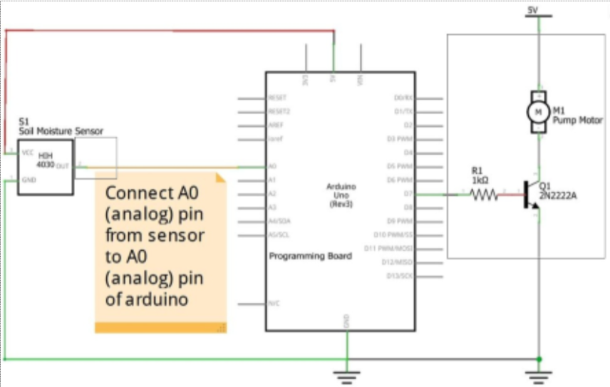
Circuit diagram

Slide 8
Presented by
Vyamesh Kumar Mishra
Tarun Bhatt
Ashutosh Sharma
Shivam Maggu

